Slide 1
Bubble Tea Expansion

Slide 2
Duplicating success for a new location
A bubble tea restaurant in Schaumburg, IL has had great success since opening
The business owner is looking to expand to a new location in Chicago, IL which can replicate the success of the original
Their success is believed to be attributed to the socioeconomic status and culture of the local area
Finding similar neighborhoods in Chicago would enable the owner to expand their business

Slide 3
Data acquisition and cleaning
Age, Education, and Income demographics for all areas from CMAP, 2019 data scraped from cmap.illinois.gov
Local business information from Foursquare, scraped in Aug. 2019 using Foursquare API
In total, 77 community areas identified along with Schaumburg, IL, with 22 features for demographics
Count-based metrics were converted to percentages, median values normalized
5693 businesses scraped, forming 362 unique business types
Businesses were grouped by community, and processed to give relative frequencies of each business type in a given community

Slide 4
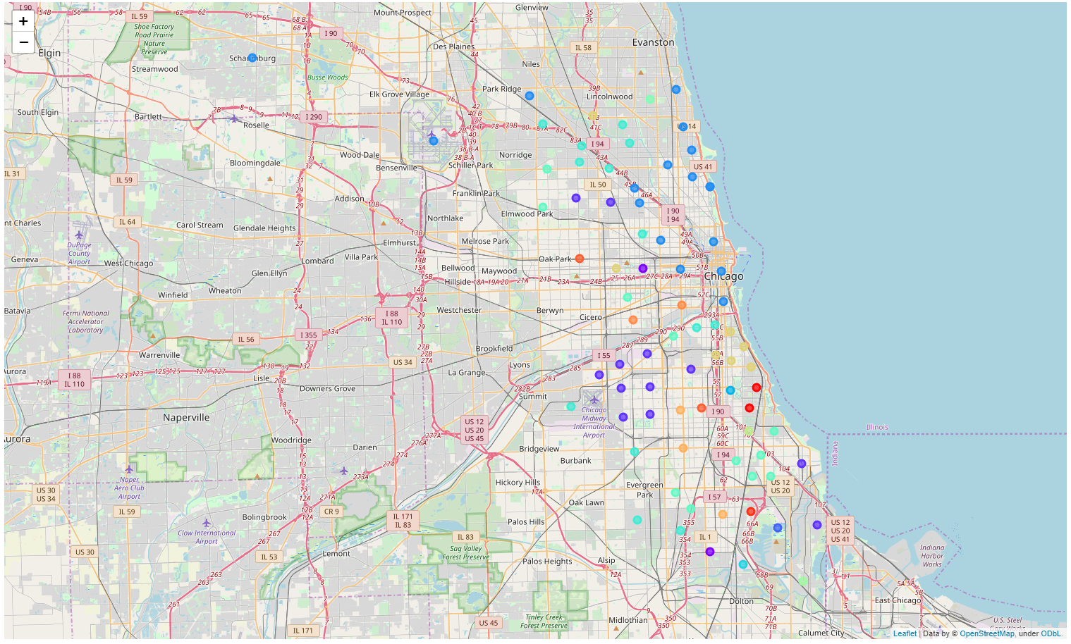
Clustering on business type
Interested in communities with similar businesses to Schaumburg, IL
(Blue Markers)

Slide 5
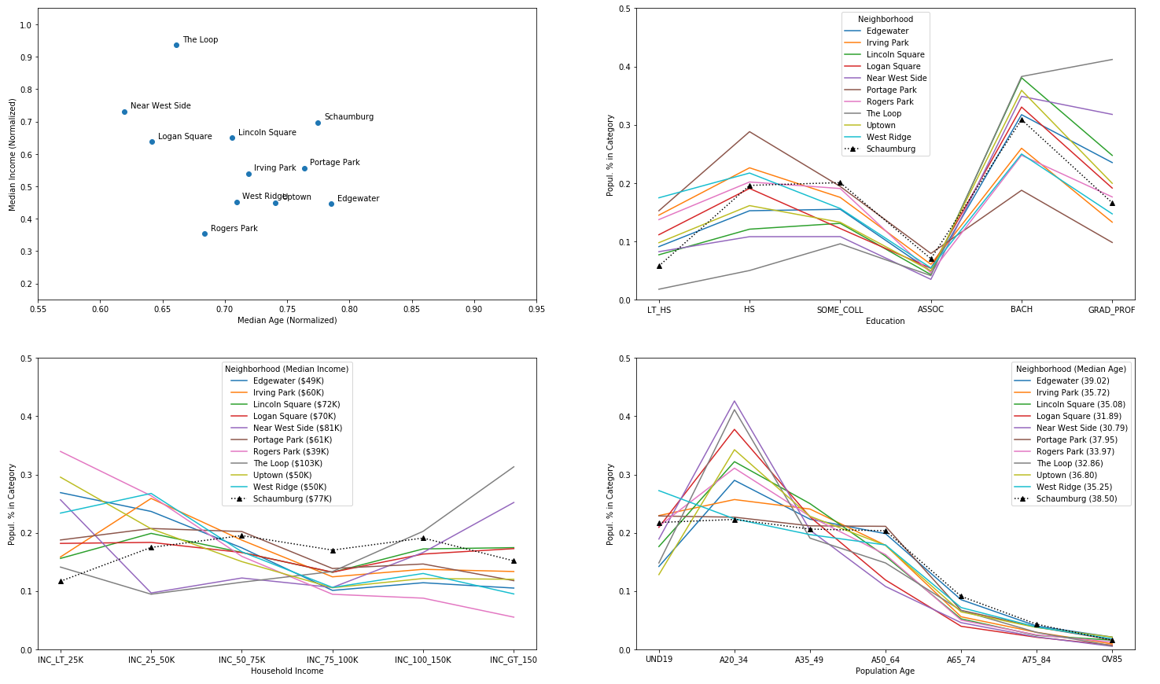
Clustering on demographics
Closest matched communities tend to have more young adults, and a less even income spread

Slide 6
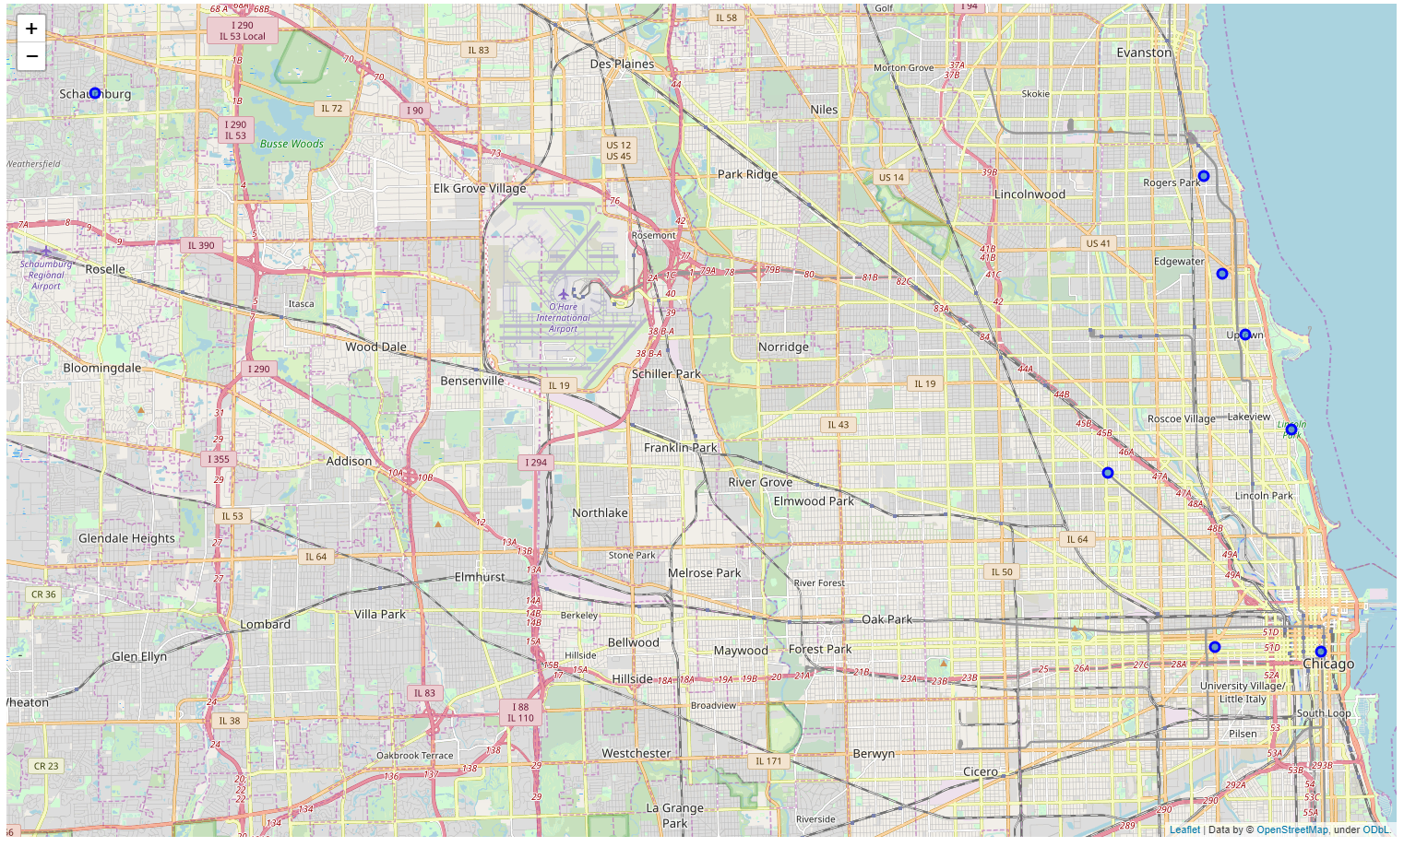
Communities from both clusterings
Communities similar in both business type and demographics tend to be North of Chicago

Slide 7
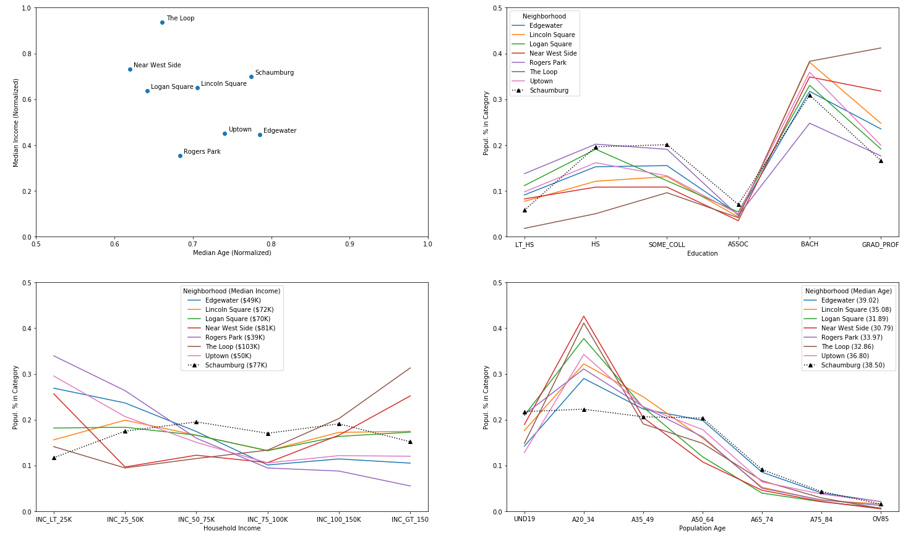
Communities from both clusterings
Young adults are even more favored by this reduced set

Slide 8
Conclusion and future directions
Business culture of Schaumburg clusters to young adult communities
Near West Side & The Loop favored by higher median income
Choosing a location will require data on rental pricing & business turnover
Improved results if business implements a reward system for demographic and return customer data
Implementation as a business tool would require new data source(s) to enable using a wider region (i.e. census data for United States)

